Slide 1

Promotion Application Report
Zhang Yifei, VCL, SRCB
2018/03/07
Copyright (C) 2018 Ricoh software research center(Beijing) Co. , Ltd
Notes:
Good morning everyone, thanks very much attending my promotion application report. I’m glad to be here to share my experiences in the past few years in SRCB.

Slide 2
Content
1. Self-Introduction
2. Job Summary
3. Planning of Future Work
Copyright (C) 2018 Ricoh software research center(Beijing) Co. , Ltd
Notes:
Today my report contains 3 parts: In the first part, I’ll give a brief introduction of myself; The second part is a summary of my work in srcb in about past 3 years; The last part is my planning for future work

Slide 3



1. Self-Introduction
张毅飞 Zhang Yifei , born in 1990/12
Apply for Deputy Researcher from Assistant Researcher
2008.09-2012.06
Bachelor's degree
Electronic Engineering
2012.09-2015.06
Master Degree
Digital Image Processing
2014.05-2014.12
Intern
2015.07 – now
Assistant Researcher
Copyright (C) 2018 Ricoh software research center(Beijing) Co. , Ltd
Notes:
My name is zhang Yifei, even though I look much older, but I pretty sure that I was born in nineteen-ninety.
Today I want to apply for promotion as an Deputy Researcher II from Assistant Research III.
I studied in Tsinghua University from 2008 to 2012 and get my bachelor’s degree in electronic engineering; In postgraduate time, I was major in Digital Image processing in University of Chinese Academy of sciences and get my master degree in 2015; In 2014, I worked as intern in SRCB from May to December; and from July 2015, I worked as assistant researcher in SRCB.

Slide 4
Content
1. Self-Introduction
2. Job Summary
3. Planning of Future Work
Copyright (C) 2018 Ricoh software research center(Beijing) Co. , Ltd
Notes:
In the second part, I’ll give a summary of my work in past few years

Slide 5
2. Job Summary
”SRCB” to summarize my main work
S, Start: Intern in Ricoh & Training
R, Robotic: Grip Posture Detection for Robot Hand
C, Cooperation : Partners, Workmates and Customers
B, BMW: Visual Based Inspection for TGY&BWM Factory.
Copyright (C) 2018 Ricoh software research center(Beijing) Co. , Ltd
Notes:
In general, I want to use the word “SRCB” to summarize my work.
S means start , this is related to my intern work and training project in SRCB
R means robotic. From 2015.7 to 2017 April, I mainly involved in the project of picking method for robot hand based on stereo camera
C means cooperation. Thanks for the good cooperation with SRCB partners, workmates and customers, I can successfully carry out my work and study.
B means BMW. Thanks to our Manager Yu-san for giving me the great opportunity, From the second half of last year, I have been involved in the visual based inspection project from TGY&BMW

Slide 6
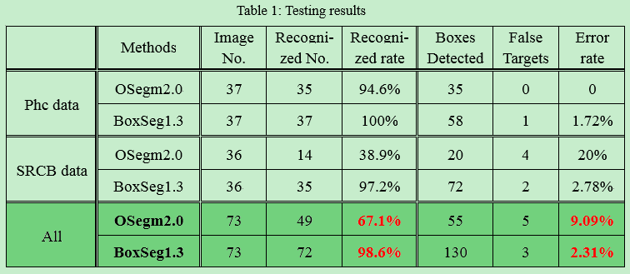
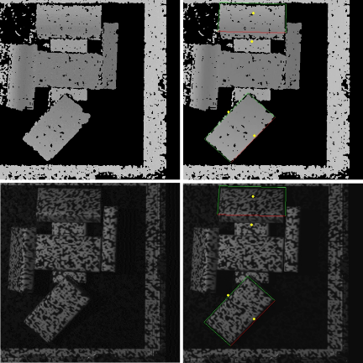
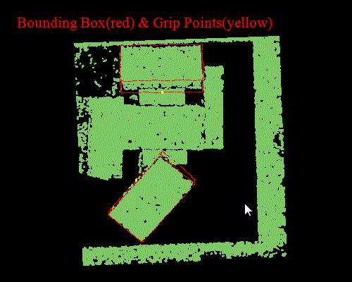
2. Job Summary
Start: Intern in Ricoh & Training
Intern: 3D Cameras: Kinect, Real-Sense, Ricoh Stereo Camera
Training: Randomly piled boxes Segmentation based on Ricoh stereo Cameras
* Comparison with OSegm2.0 ( A primary version of the picking method )
Input Image
Result Image
Bounding Box & Grip Points
Patent ID 356: A rectangle detection method
Copyright (C) 2018 Ricoh software research center(Beijing) Co. , Ltd
Notes:
During my internship, I mainly researched and tested different kinds of 3D cameras, such as Microsoft Kinect, Intel real-sense, Ricoh stereo camera and so on.
Especially Ricoh stereo camera, this laid a good foundation for my future work.
In my training project, I developed a segmentation method based on gray and depth image, this method performs well for randomly-piled boxes. A simple comparison shows that method performs much better than a primary version of the picking library.
Based on my training project, I applied a patent named “A rectangle detection method”.

Slide 7
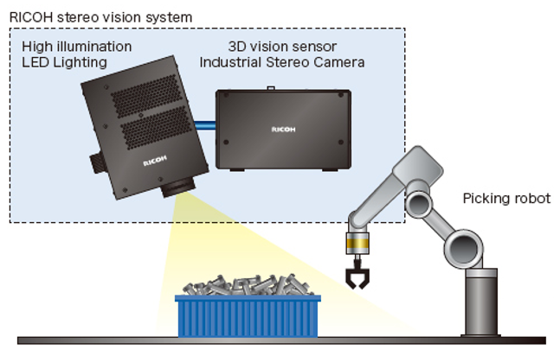
2. Job Summary
Robotic: Grip Posture Detection for Robot Hand
Eye: Ricoh Stereo Camera; Hand: Vacuum adsorber & Gripper
Brain: SRCB’s Grip/Adsorb posture estimation algorithm
My work: Design detailed algorithm after discussion
with my partner; Implement and test the program.
* Comparison with HALCON’s library (by Nagashima-san from Phc)
Evaluation | Success Rate | Speed
SRCB | 98% | 1.3 Sec (10 pieces) 1.7 Sec (100 pieces)
HALCON | 90% | 1.7 Sec (10 pieces) 3.7 Sec (100 pieces)
Patent ID 375: Tri-Point Features for 3D Recognition and Pose Estimation
Patent ID 407: Picking method for randomly placed objects
Copyright (C) 2018 Ricoh software research center(Beijing) Co. , Ltd
Notes:
From 2015.7 to 2017 April, I mainly involved in the project of picking method for robot hand based on stereo camera.
In the picking system built by Phc, they use Ricoh stereo camera as eye; use adsorbers and grippers as hand.
For SRCB, we developed the brain of the robot to calculate picking postures based on intensity and depth image.
In this project, I mainly responsible for designing detailed algorithm after discussion with my partner and then implementing and testing the library.
Nagashima-san evaluated our library in Phc. Experiment shows our library is more accurate and more faster than HALCON, especially when detecting more targets simultaneously.
We applied 2 patents relevant to posture detection based on this project,

Slide 8
2. Job Summary
Cooperation: Partners, Workmates and Customers
SRCB Partners
SRCB’s 4th Badminton Competition (2016, 50 members 35 games)
Annual Meeting of the Year 2016 (2 Day’s activity in suburb of Beijing)
Team Building Activities (Mountaineering, Home Party)
Workmates of BMW projects
Cooperation with PLC Engineer, DB Developer and Project Manager.
Customers
Understand our customers from TGY and BMW, based on understanding of actual production process in plant.
Copyright (C) 2018 Ricoh software research center(Beijing) Co. , Ltd
Notes:
Cooperation is always the most important for team work. In past few years, I took part in so many meaningful activities.
In 2016, I am responsible for the organization of our badminton competition and annual meeting in suburb of Beijing.
For BMW project, good communication with develop engineers and project manager is the most important foundation.
And I always remember to understand our customers’ requirements from TGY and BMW.
Thanks for all the great cooperation with SRCB partners, workmates and customers, I can successfully carry out my work and study.

Slide 9
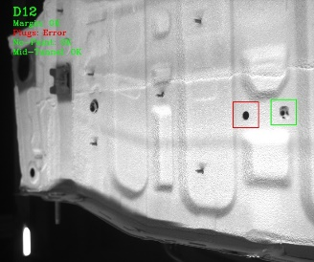
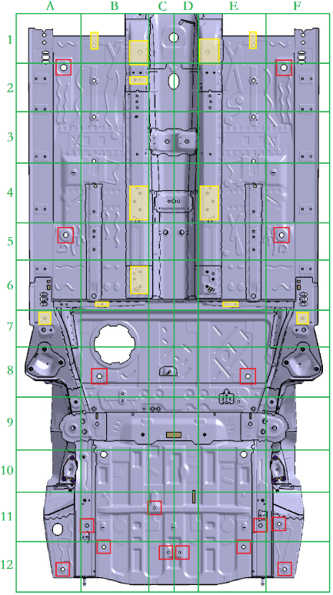
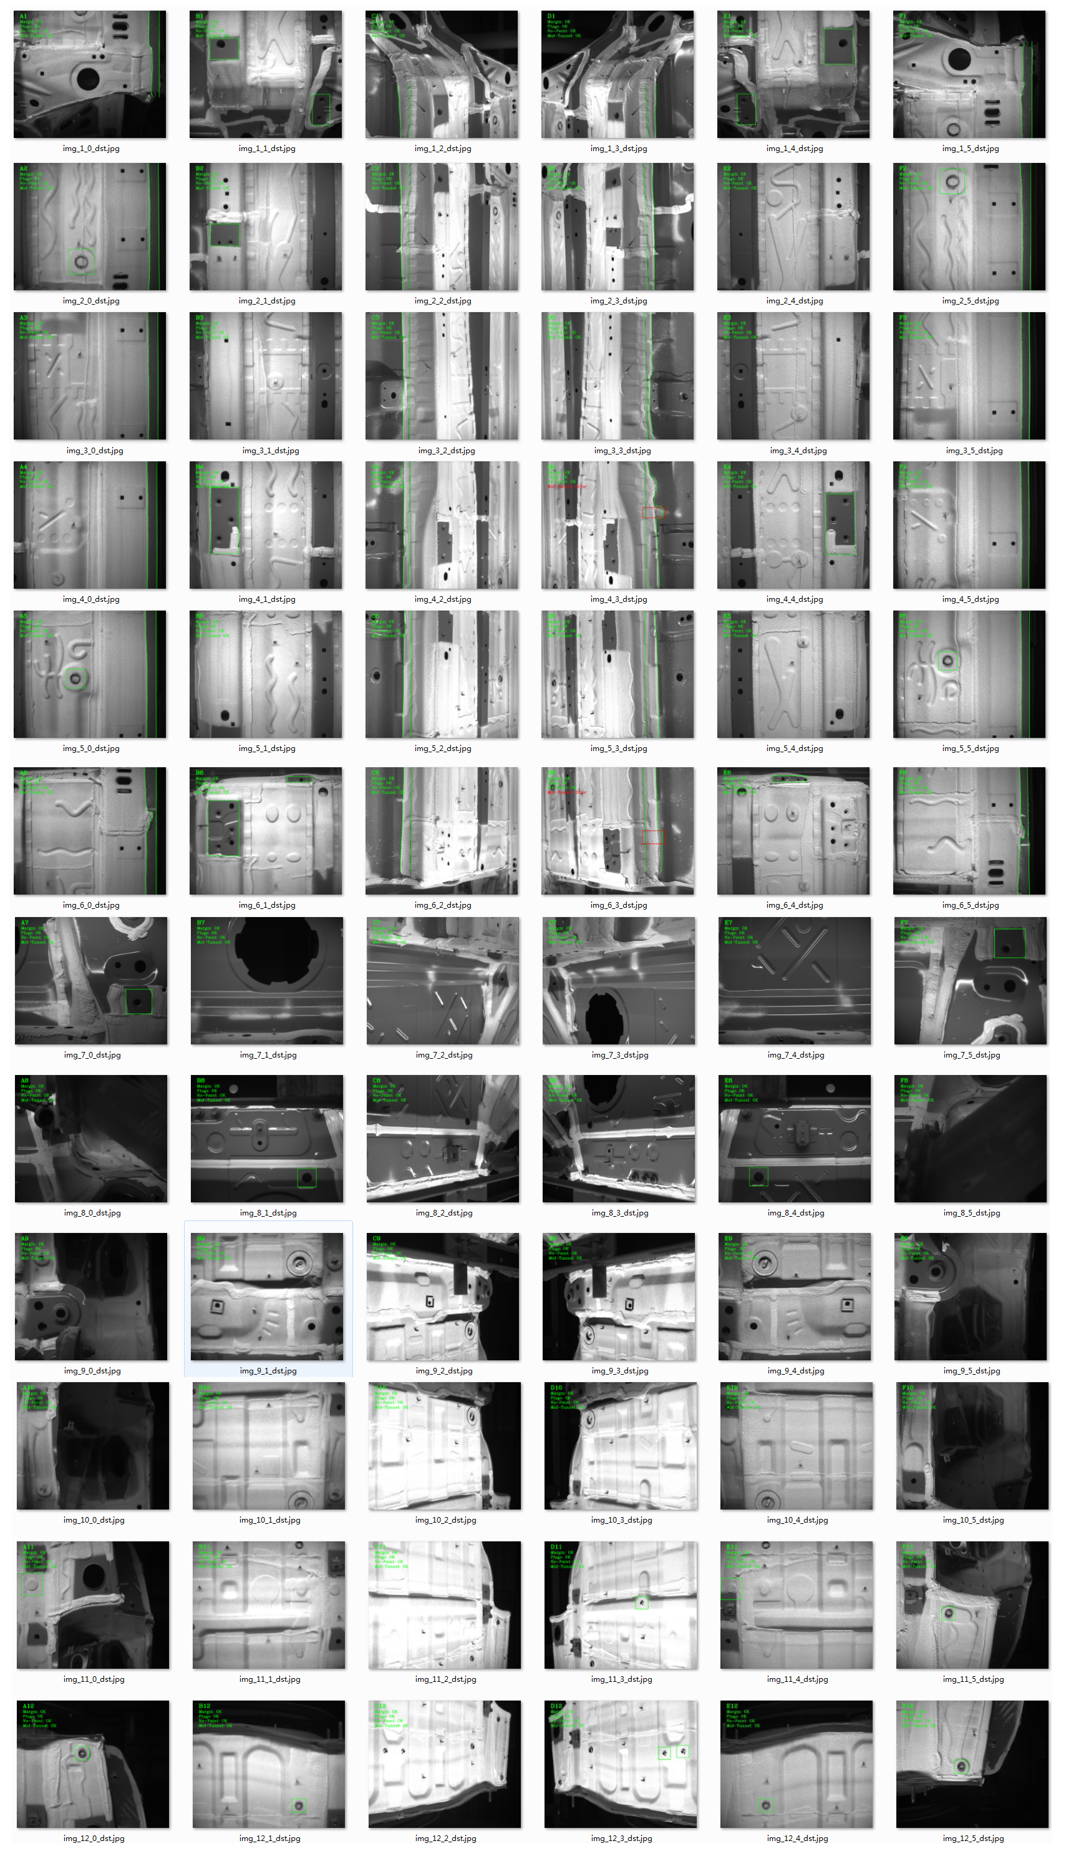
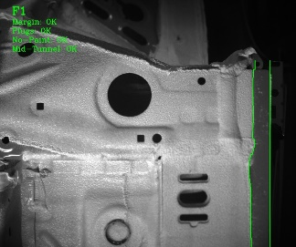
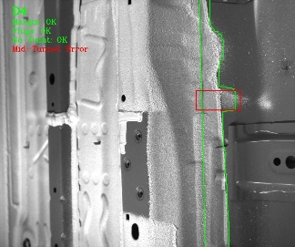
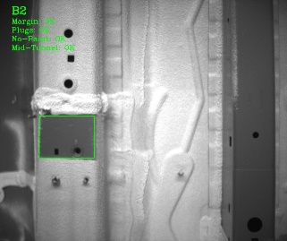
2. Job Summary
BMW: Visual Based Inspection for FA
PVC Inspection system Phase I
72 Pics per Car: 6 Cams & 12 Shots
4 Targets: Plugs, Margin, Mid-tunnel Airless area
My Work: Develop the Plugs ,Margin, Mid-tunnel
area inspection method; Integration and testing;
* Evaluation based on more than 591 cars
Evaluation | Plugs | Margin & Mid-Tunnel | Airless
Accuracy | 100% | - | -
Precision | - | < 1mm | Requirements Change
Copyright (C) 2018 Ricoh software research center(Beijing) Co. , Ltd
Notes:
In the last year, I mainly involved in the PVC inspection project Phase I.
In this project, we captured 72 pictures to cover the underbody of one car, shooting 12 times with 6 cameras, as shown in the right image.
For each car, we have 4 kinds of targets to detect and inspect: plugs, margin area, mid-tunnel area and Airless area.
In this project, I mainly developed the inspection algorithm for plugs, margin area and mid-tunnel area, including library integration and testing.
We have test the library with images from 591 cars. All the plugs area are detected and judged correctly; For the margin and mid-tunnel area, the detect resolution is under 1 millimeter.
The airless area is not included because BWM changed their requirements recently.

Slide 10
Content
1. Self-Introduction
2. Job Summary
3. Planning of Future Work
Copyright (C) 2018 Ricoh software research center(Beijing) Co. , Ltd
Notes:
In the last part, I want to talk about my plans for future work

Slide 11
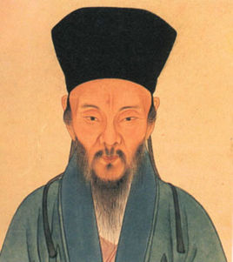
3. Planning of Future Work
知行合一：The Unity of Inner knowledge and Action
Keep up with the latest research and technology
in machine vision
Apply related technology
to actual project
Cooperate with partners
Understand our customers
王守仁，字伯安，号阳明,“心学”创始人。
Wang Yangming, master of the “Heart-mind Theory”
Copyright (C) 2018 Ricoh software research center(Beijing) Co. , Ltd
Notes:
There was a great philosopher named wangyangming, who is the master of heart-mind theory in Ming-dynasty in ancient china.
One of his main idea is “ The unity of inner knowledge and action”, which gives me great inspiration for my research and work.
I think I should always remember three key points: 1. keep us with latest research in machine vision; 2. Apply related technology to actual project; 3. Cooperate with my partners and understand our customres.

Slide 12
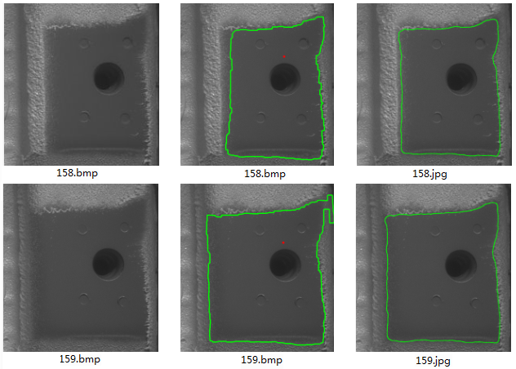
3. Planning: Apply knowledge to Action
Research: Combination of Traditional Image Pro and Deep Learning.
Opportunity: Deep Learning gives excellent results.
Challenge: Difficult to apply for online FA systems because of High Computations. Efficiency is always the most important in plant.
Outputs: Papers, Patents
Original Image
Traditional method
Deep Learning
e.g: For Airless area detection, deep learning method gives more smooth and stable segmentation results; While the computing time(~ 2.65 sec) of deep learning is about 20 times more than traditional method(~0.1s).
Copyright (C) 2018 Ricoh software research center(Beijing) Co. , Ltd
Notes:
In recently years, deep learning offers us great opportunities in machine because the performance is much better and more stable than traditional method in many areas.
While there are also many challenges for deep learning, one of the most important is how to applied to on line FA systems because of high computations. We all know that efficiency is always the mort important in plant.
I think on one hand I should make good use of deep learning, on the other hand, we should keep a balance between traditional image processing method and deep learning.
For example, for the airless detection in PVC inspection projects. Deep learning gives more smooth and stable segmentation results, while the computing time is much more than traditional method.

Slide 13
3. Planning: Apply knowledge to Action
Research: Combination of Traditional Image Pro and Deep Learning.
Application: Great opportunities for TGY&BMW
Extend current technology to more product line
PVC Inspection Phase II in Tiexi Plant (within 2019)
New PVC Inspection project in NEX Plant (within 2018)
Find new requirements from BWM
Visual Positioning for Grinding system (within 2018)
Visor-Signage inspection (within 2018)
Auto Positioning for Battery Installation (in Application)
From BWM to More Factories
Surface quality inspection ( further research from Brilliance Auto)
Seam measurement (further research from Brilliance Auto)
To be continued…
Outputs: Patents, Libraries
Copyright (C) 2018 Ricoh software research center(Beijing) Co. , Ltd
Notes:
For application, TGY&BMW offer us a great opportunity to step into visual inspection systems in factory automation area.
On one hand, we’ll extend current technology to more plant in BMW. The PVC inspection project phase II in Tiexi plant and new PVC inspection system in NEX plant will start soon;
On the other hand, we keep find new requirements form TGY&BMW. More application such as visor-signage inspection and visual position systems are under application;
Also ,thanks to TGY’s strong market ability, we may cooperate with much more factories. For example, the Brilliance auto shows great interest to cooperate with us to developed surface inspection of metal plant.
In this application development, we can also find more patent ideas.

Slide 14
Thank you!
Q & A
Copyright (C) 2018 Ricoh software research center(Beijing) Co. , Ltd
Notes:
Thanks for listening. This’s all!

